Slide 1
Latent Dirichlet Allocation

Slide 2
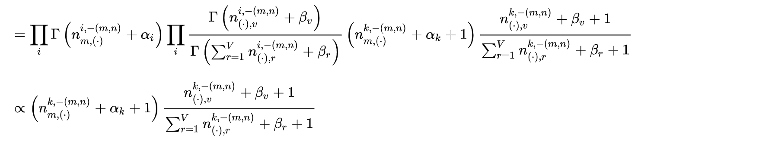
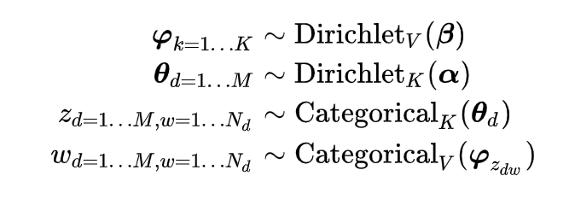
LDA w/ gibbs sampling
Formal Definition

Slide 3
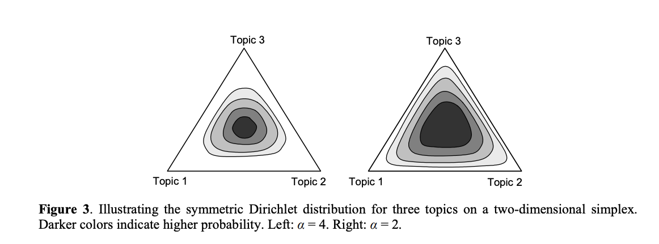
Source: Steyvers, M., & Griffiths, T. (2007). Probabilistic topic models. Handbook of latent semantic analysis, 427(7), 424-440. https://cocosci.princeton.edu/tom/papers/SteyversGriffiths.pdf

Slide 4
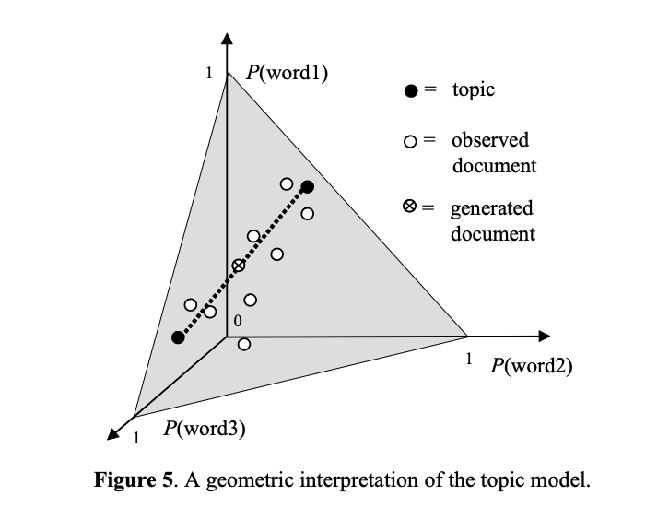
Source: Steyvers, M., & Griffiths, T. (2007). Probabilistic topic models. Handbook of latent semantic analysis, 427(7), 424-440. https://cocosci.princeton.edu/tom/papers/SteyversGriffiths.pdf

Slide 5
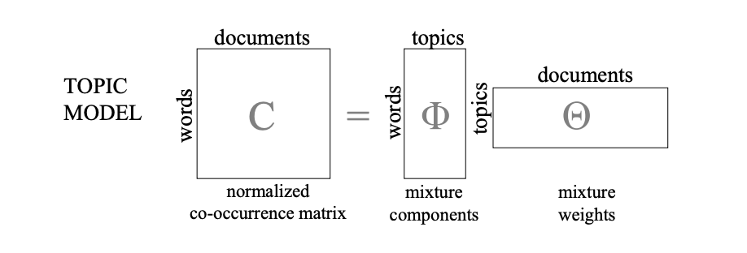
Source: Steyvers, M., & Griffiths, T. (2007). Probabilistic topic models. Handbook of latent semantic analysis, 427(7), 424-440. https://cocosci.princeton.edu/tom/papers/SteyversGriffiths.pdf
#Goals
• For each document, allocate its words to as few topics as possible.
• For each topic, assign high probability to as few terms as possible.

Slide 6
Source:
Kim, J., Park, M., Kim, H., Cho, S., & Kang, P. (2019). Insider threat detection based on user behavior modeling and anomaly detection algorithms. Applied Sciences, 9(19), 4018.

Slide 7
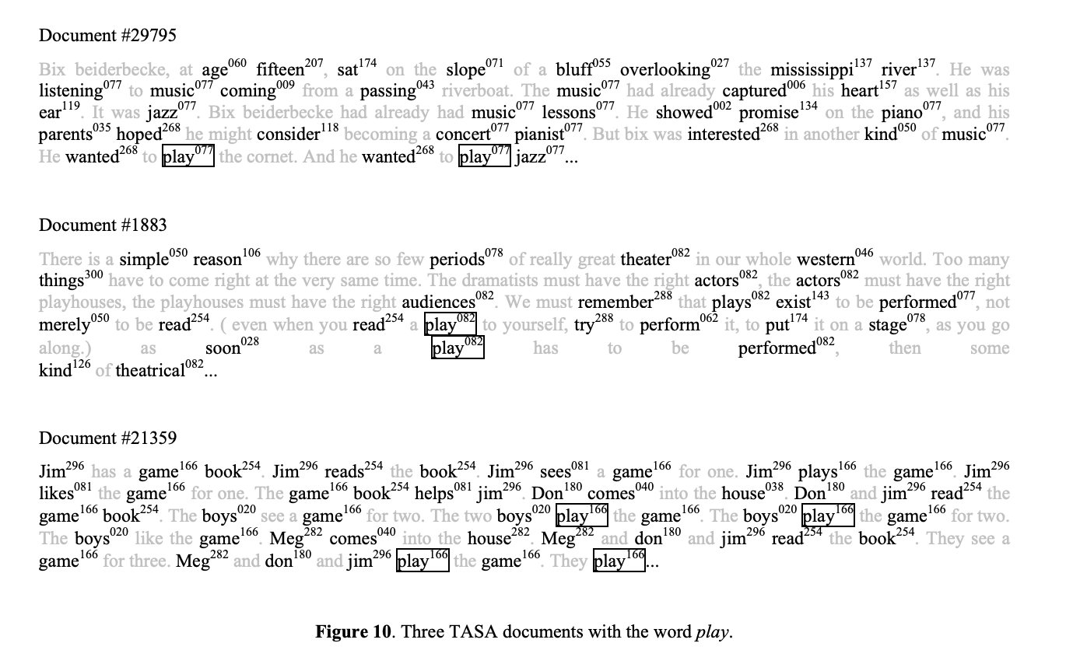
Source: Steyvers, M., & Griffiths, T. (2007). Probabilistic topic models. Handbook of latent semantic analysis, 427(7), 424-440. https://cocosci.princeton.edu/tom/papers/SteyversGriffiths.pdf
LDA models can handle Polysemy!

Slide 8
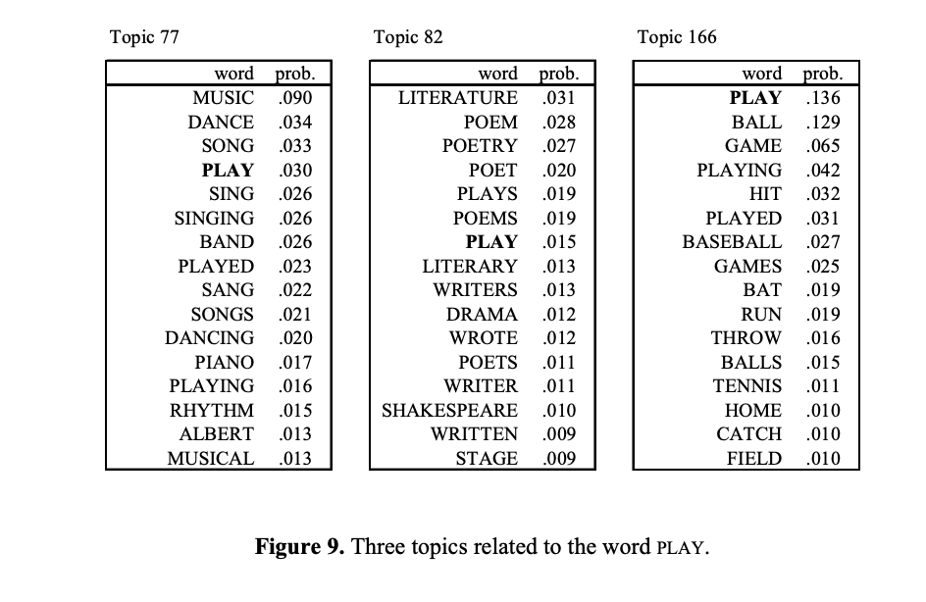

Slide 9
Breaking LDA Open

Slide 10
Raw Data
Lets run an LDA model on 7 documents and tell the algorithm that there are 2 topics. Here are our 7 documents (not will be highlighted):
[1] ’Evan does not believe in caramel',
[2] ’caramel is the worst food on the planet’,
[3] ’caramel is not a food',
[6] ’Evan believes in chocolate',
[5] ’chocolate believes in Evan',
[6] ’If I one wish, caramel would no longer exist’
[7] 'je suis tellement fatigué’
"not" (3)
[1] 1 2 3 4 5 6
[2] 6 7 8 9 10 11 8 12
[3] 6 7 3 13 10
[4] 1 14 5 15
[5] 15 14 5 1
[6] 16 17 18 19 6 20 21 22 23
[7] 24 25 26 27

Slide 11
First, the LDA algorithm will randomly assign each word in each document a topic. It’s fully random- the same word can fall into different topics. Here are the initial topic assignments for each word in each document. (1 = topic1, 2 = topic2)
Table_1
[Doc1] 2 1 2 1 1 1
[Doc2] 1 1 2 2 1 1 2 1
[Doc3] 2 2 1 2 1
[Doc4] 1 1 1 1
[Doc5] 1 2 1 2
[Doc6] 1 2 1 1 2 2 1 2 1
[Doc7] 2 2 1 1

Slide 12
Table_2
LDA will then count the number of words that fall into each topic- we see the same information as above, just in a different form. The columns are words, the rows are topics, the values are counts.
[,1] [,2] [,3] [,4] [,5] [,6] [,7] [,8] [,9] [,10] [,11] [,12] [,13] [,14] [,15] [,16] [,17]
[1,] 1 1 1 1 3 2 1 0 0 2 1 1 0 1 2 1 0
[2,] 2 0 1 0 0 2 1 2 1 0 0 0 1 1 0 0 1
[,18] [,19] [,20] [,21] [,22] [,23] [,24] [,25] [,26] [,27]
[1,] 1 1 0 1 0 1 0 0 1 1
[2,] 0 0 1 0 1 0 1 1 0 0

Slide 13
Table_3
Next LDA will use this table to update a document-level count matrix for topic 1 and topic 2 across all 7 documents. I’ve highlighted the topics “not” (3) falls into. The values in the table are the number of words that fell into topic 1 and topic 2 after random assignment.
Topic_1 Topic_2
Doc1 5 1
Doc2 6 2
Doc3 1 4
Doc4 3 1
Doc5 2 2
Doc6 6 3

Slide 14
Once our 3 tables are set up, LDA then wiggles the values in these tables and uses that wiggle to calculate probabilities and update the above tables. The math for this really isn’t that important. Keep in mind that the only two real inputs are words and document. In theory, the more iterations we run, the more stable these probability distributions will become. But what happens when there are or words that only appear once? What happens if documents/ terms can fall into multiple categories (as they all do)? If I tell LDA to wiggle-update 10,000 times, here are the terms that change topics on the 10,000th run (when the model should be ‘stable!’):
"iter:10000 doc:1 token:2 topic:2=>1"
"iter:10000 doc:2 token:4 topic:1=>2"
"iter:10000 doc:2 token:6 topic:2=>1"
"iter:10000 doc:2 token:8 topic:1=>2"
"iter:10000 doc:6 token:3 topic:2=>1"
"iter:10000 doc:6 token:6 topic:2=>1"
"iter:10000 doc:7 token:1 topic:2=>1"
"iter:10000 doc:7 token:2 topic:1=>2"
"iter:10000 doc:7 token:3 topic:2=>1"
"iter:10000 doc:7 token:4 topic:1=>2”

Slide 15
So why is topic modeling so unstable for twitter?
50%-70% of twitter data are words that only occur once. This hugely affects probility distributions! When you run LDA on a big twitter dataset, you can see half or more of your words changing topics every run.
Documents are short, so not many words co-occur- this means the probability distributions are unstable.
The starting “random" topic assignment can change the underlying distribution - meaning that changing seeds (the starting-point) makes the algorithm unstable.
There are many ties that can push words/ documents into different topics.
We pull data by keywords, so these are predetermined to be present in most topics
There are additionally some math reasons- Dirichlet distributions assume each document contains multiple topics- tweets do not. There are some additional hyperparameter things as well, and these serve to exacerbate the problems caused by issues 1-5.

